Slide 1

Instance Selection for In-context Learning
Kun-Peng Ning

Slide 2
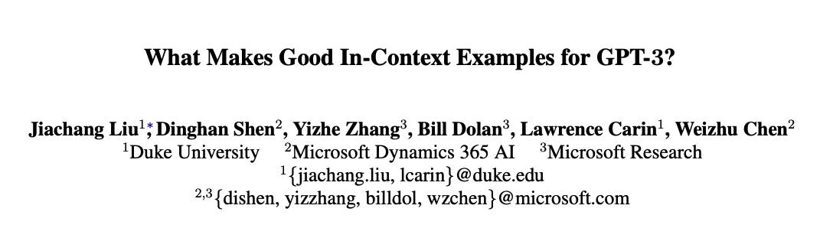
Motivation
ACL-W, 2021, citation 621

Slide 3
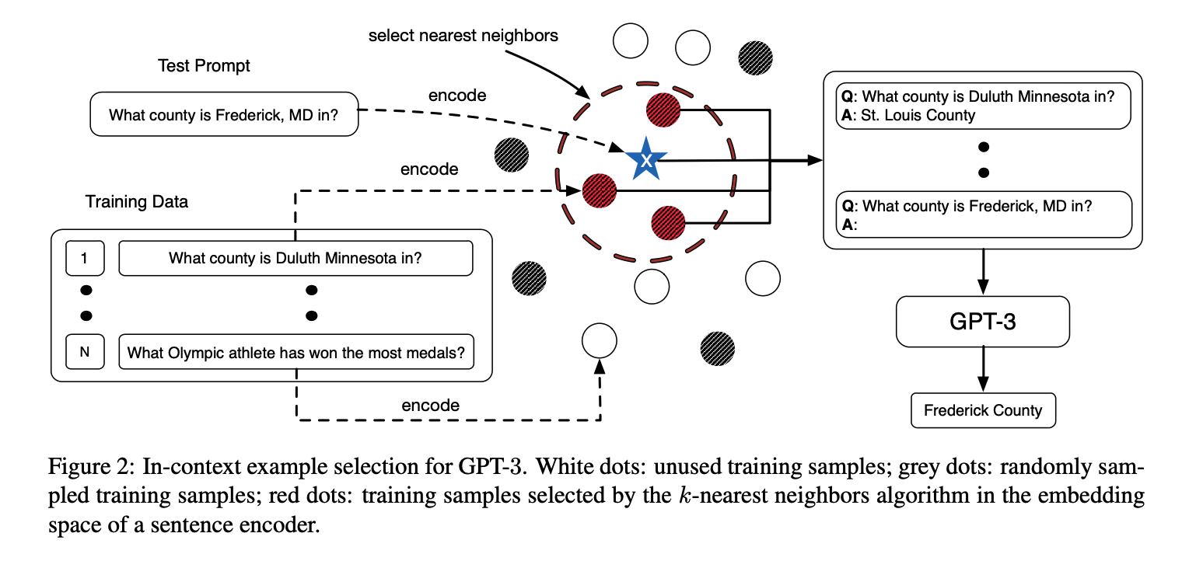
Motivation
RAG（Retrieval-Augmented Generation）
KATE: Large labeled set -> Small labeled set -> Prompt

Slide 4
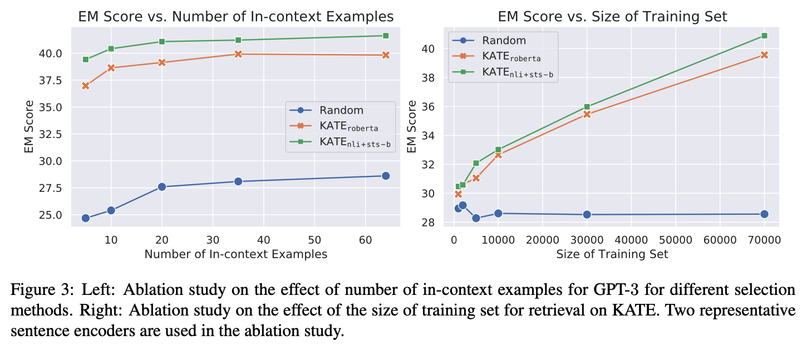
Motivation
Carefully designed instance selection is effective.
The larger the candidate(knowledge) set, the better the performance.
Supervised scenario.

Slide 5

ICLR’23, citation 86

Slide 6
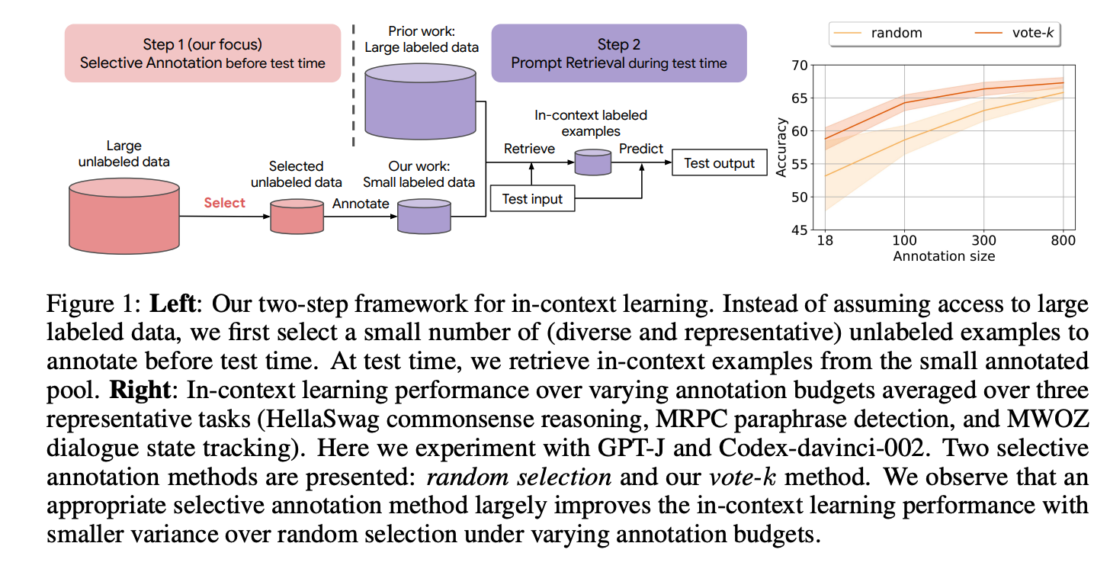
Vote-k
Unsupervised scenario.
Two-step framework.
Vote-k selective annotation yields similar performance to state-of-the-art
supervised finetuning with 10-100×less annotation cost.

Slide 7

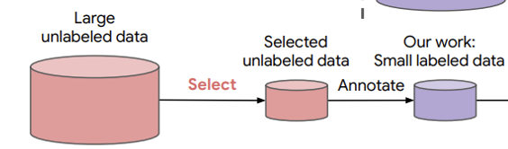
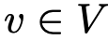
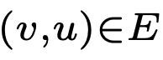
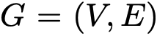
Vote-k
Combine diversity and representativeness
Sentence-BERT

Slide 8
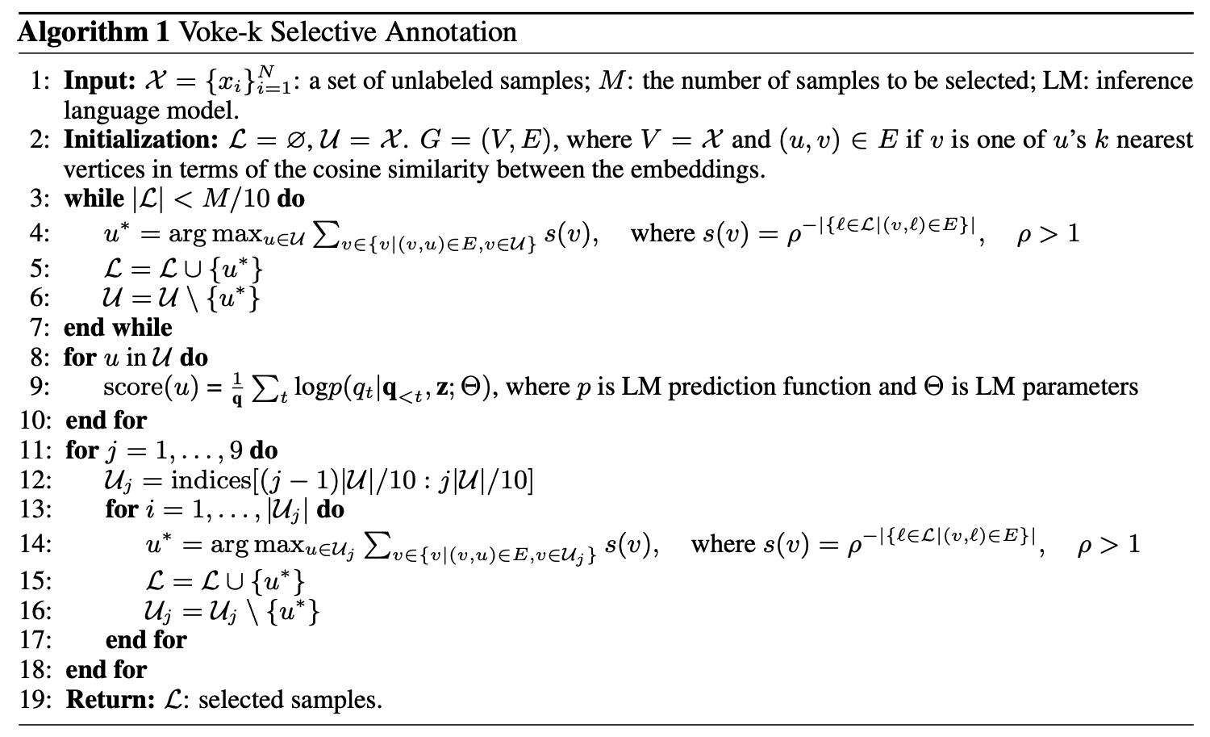
Vote-k

Slide 9
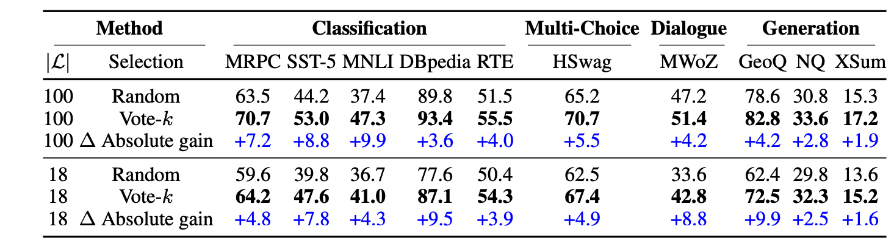
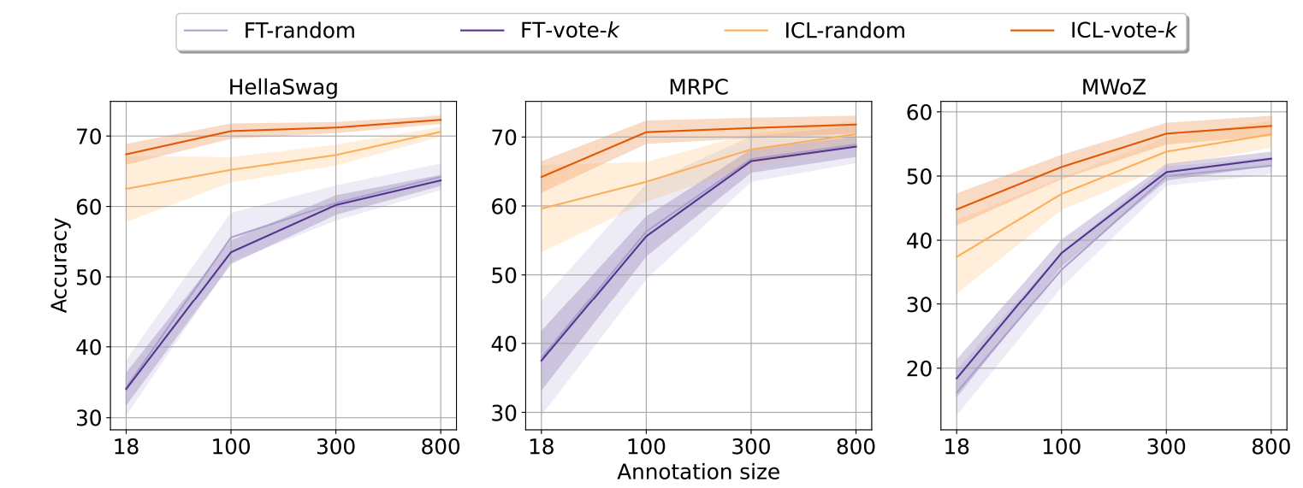
Vote-k

Slide 10
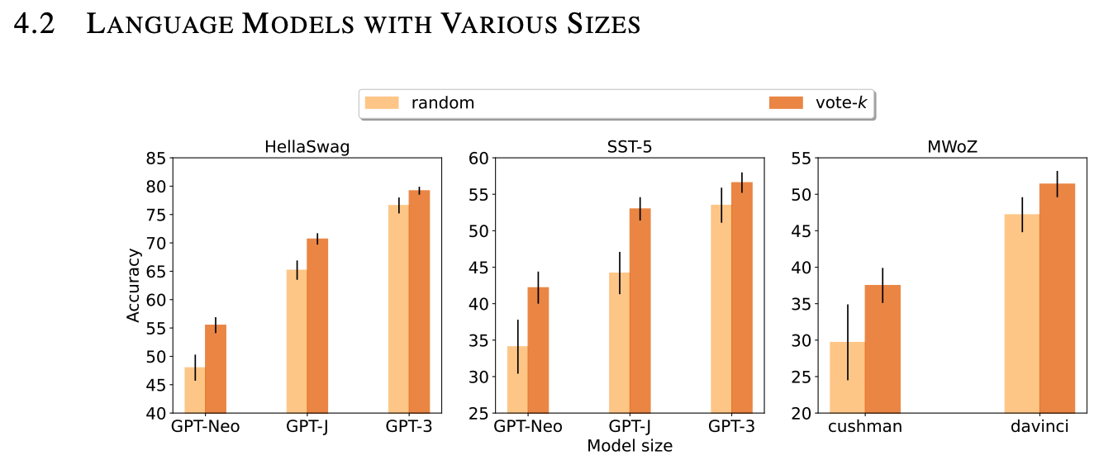
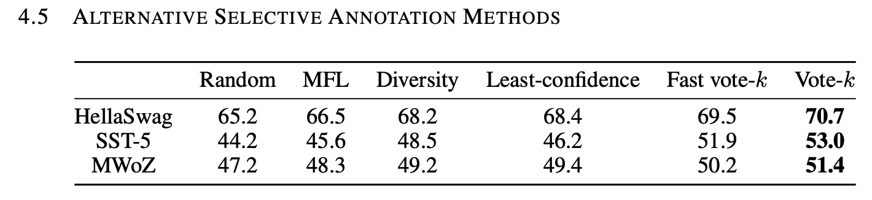
Vote-k

Slide 11
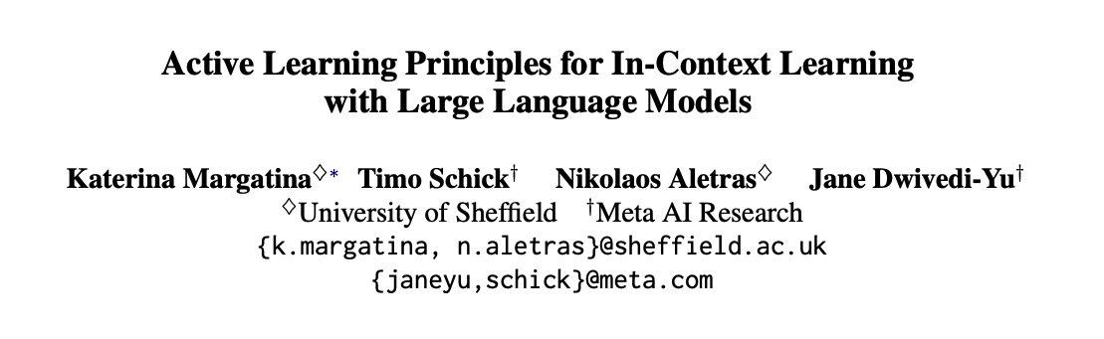
EMNLP’2023, citation 8

Slide 12
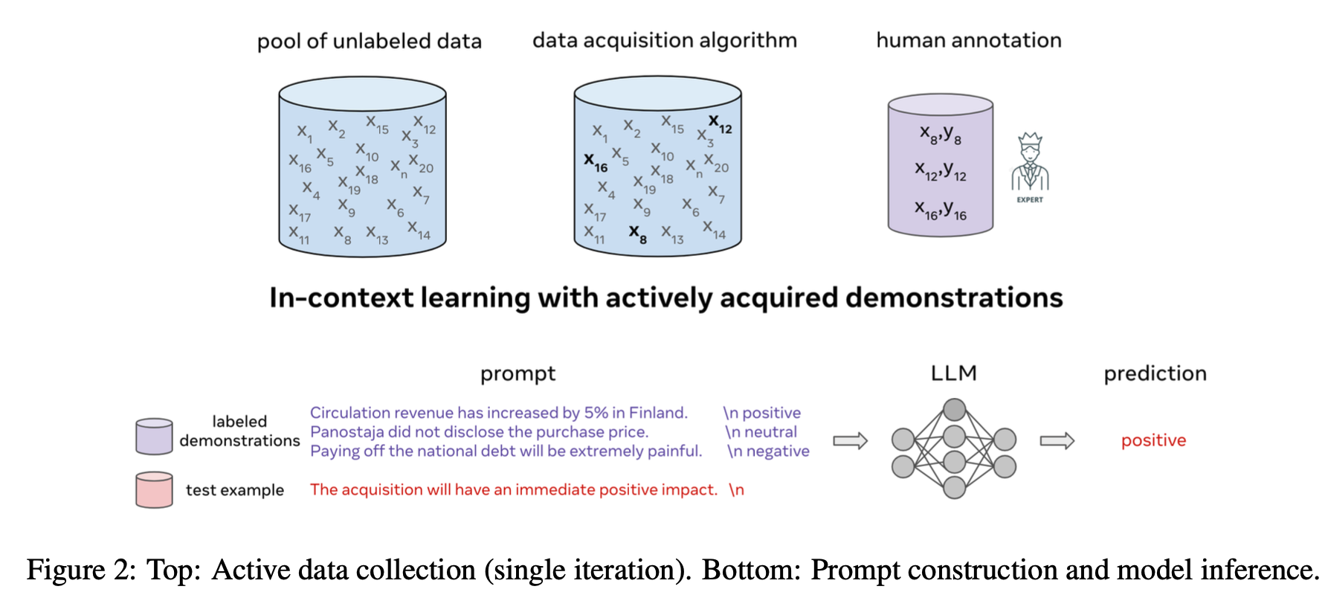
Active Learning Principles for ICL

Slide 13
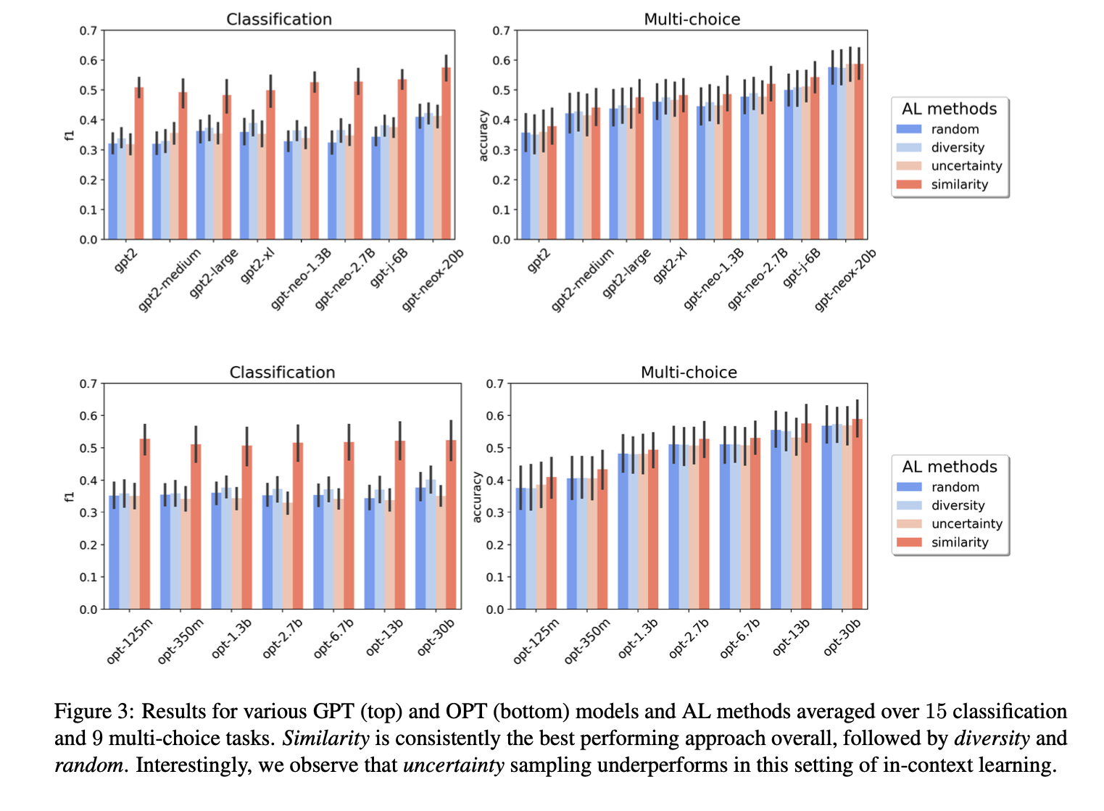
Active Learning Principles for ICL

Slide 14
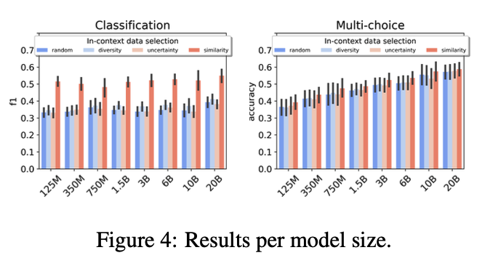
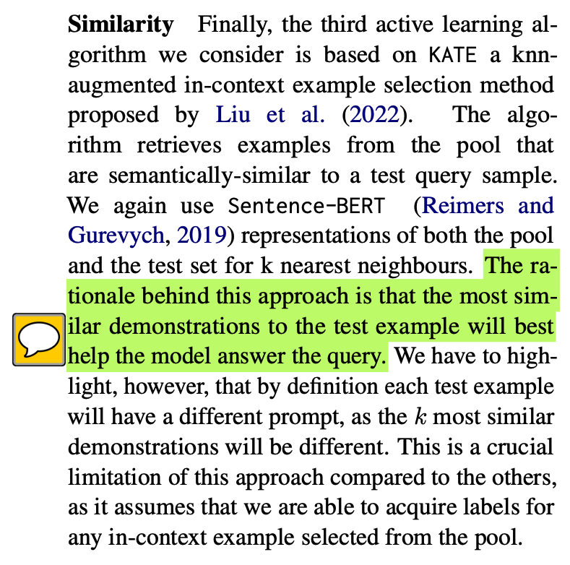
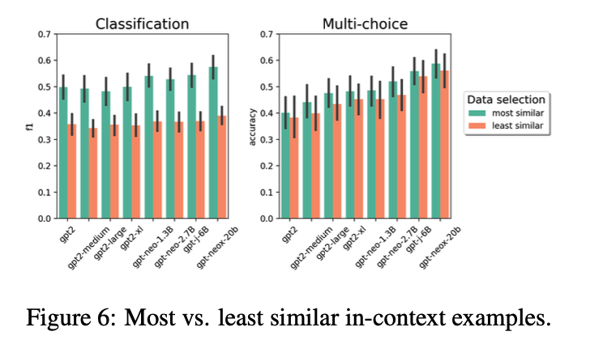
Active Learning Principles for ICL

Slide 15
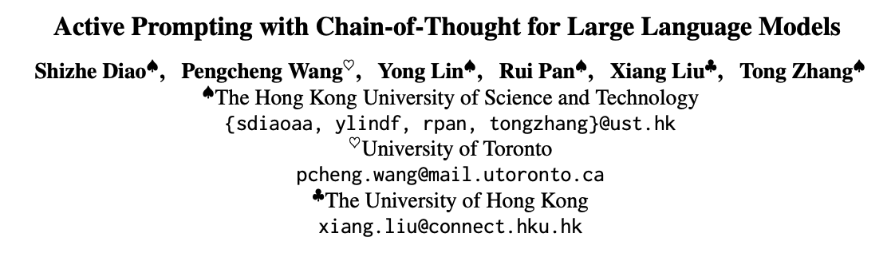
Arxiv’2023, citation 58

Slide 16
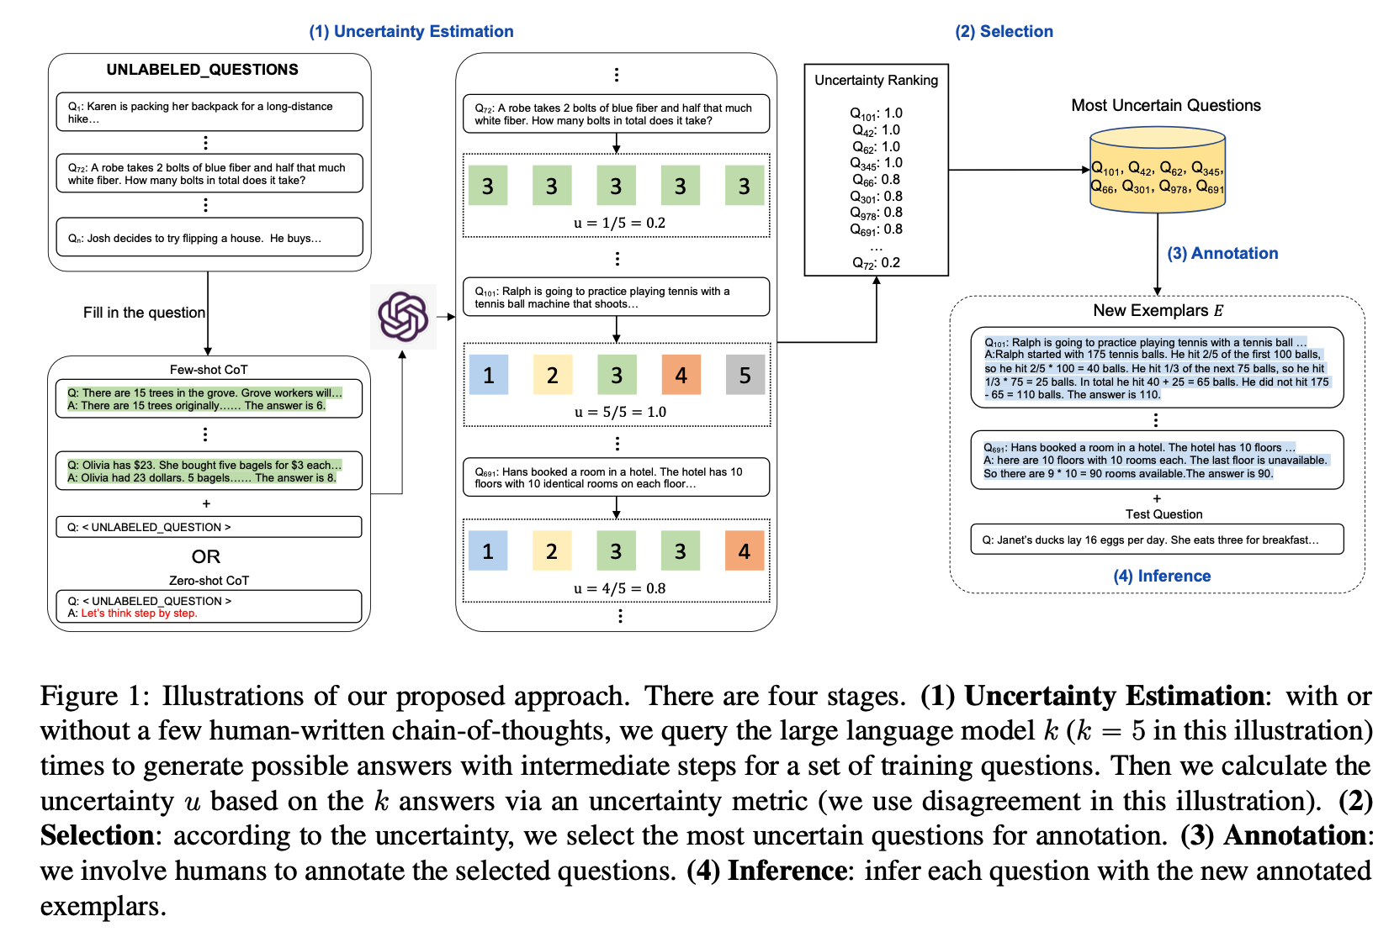
Active Prompt

Slide 17
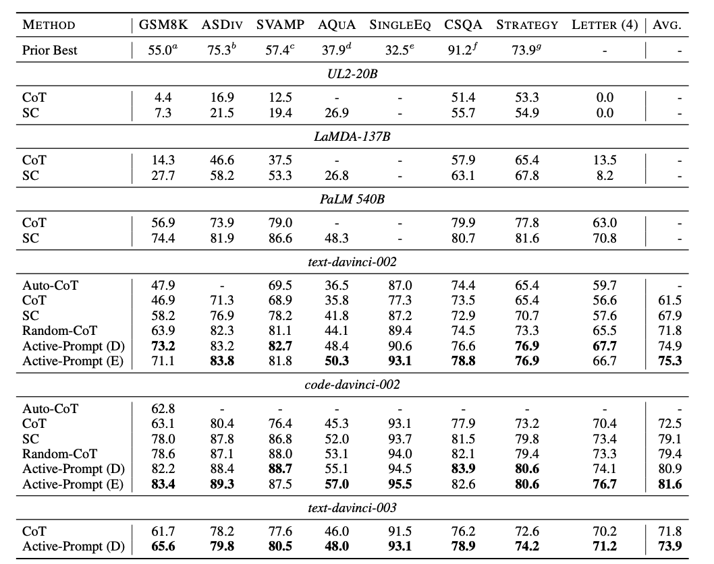
Active Prompt

Slide 18
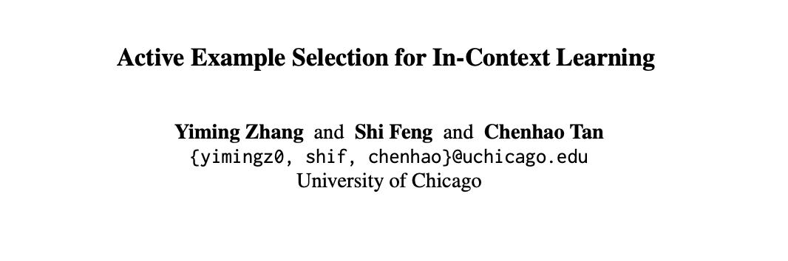
EMNLP’2023, citation 60

Slide 19
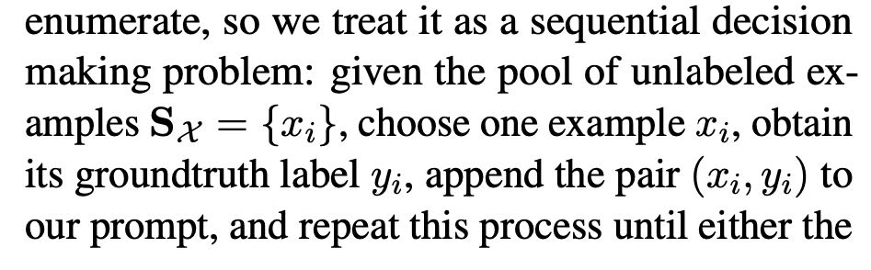
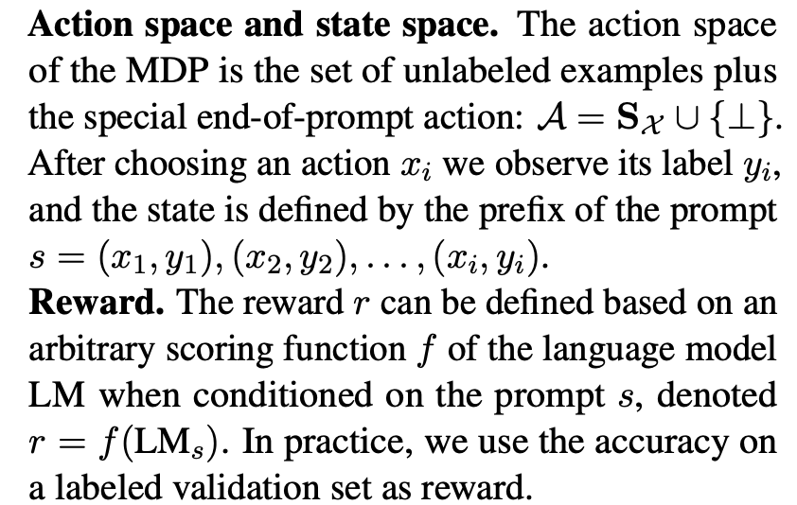
Active Example Selection By RL
Maximize the expected accuracy on unseen test examples by getting up to k annotations.
Large labeled set -> Small labeled set (Follow KATE)

Slide 20
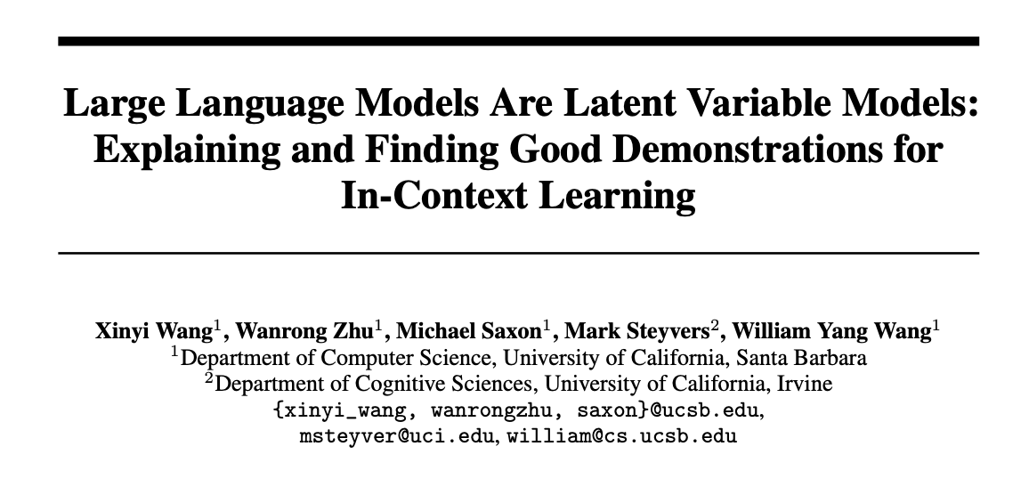
NIPS’2023, citation 5

Slide 21
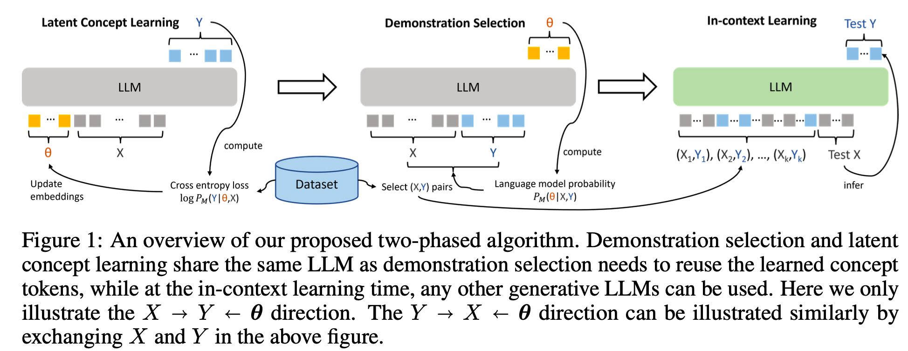
Method
The author propose an algorithm to select optimal demonstrations from a set of annotated data with a small LM, and then directly generalize the selected demonstrations to larger LMs.
Large labeled set -> Small labeled set (Follow KATE)

Slide 22
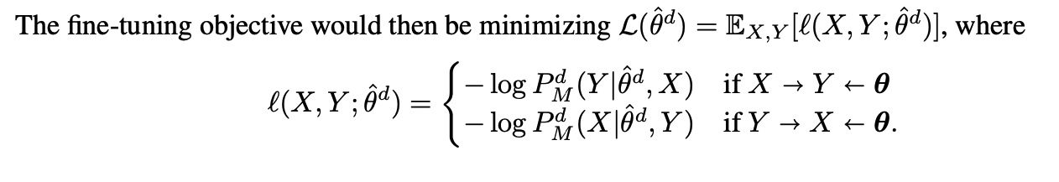
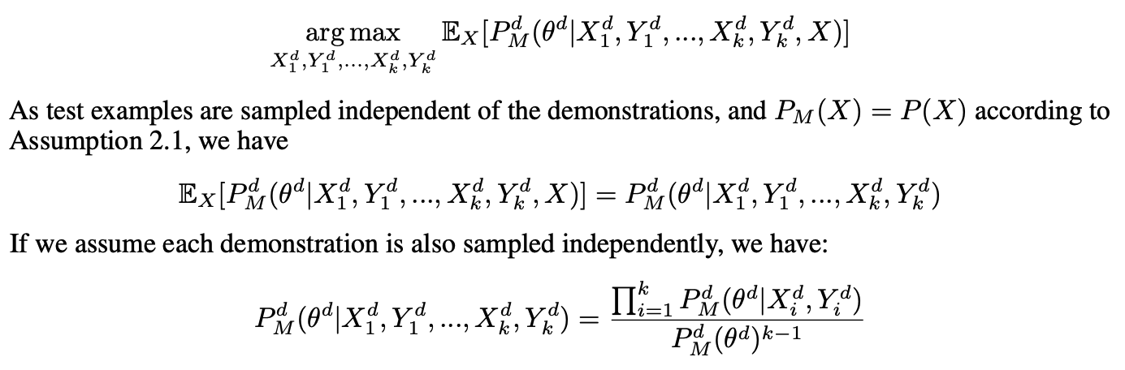
Method
Latent Concept Learning (Prompt-tuning)
Demonstration Selection
The goal is to learn $θ^{d}$ to encode both task $d$ and format information.

Slide 23
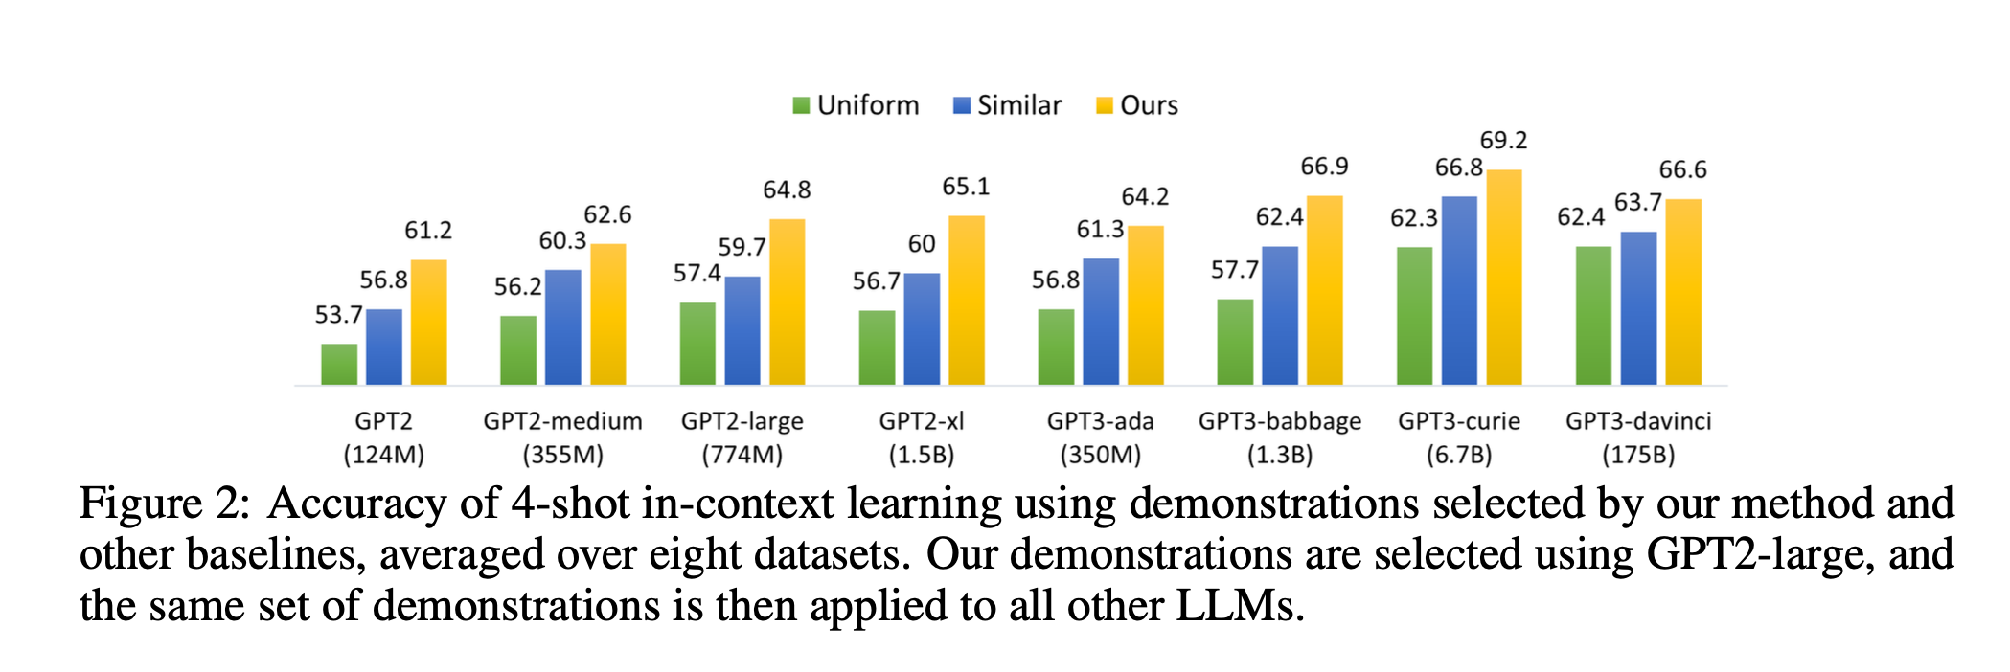
Method
KATE

Slide 24
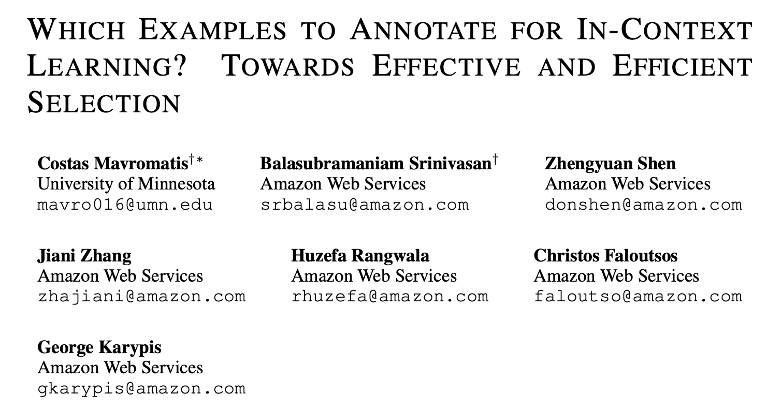
ICLR’2024, under review, citation 5

Slide 25
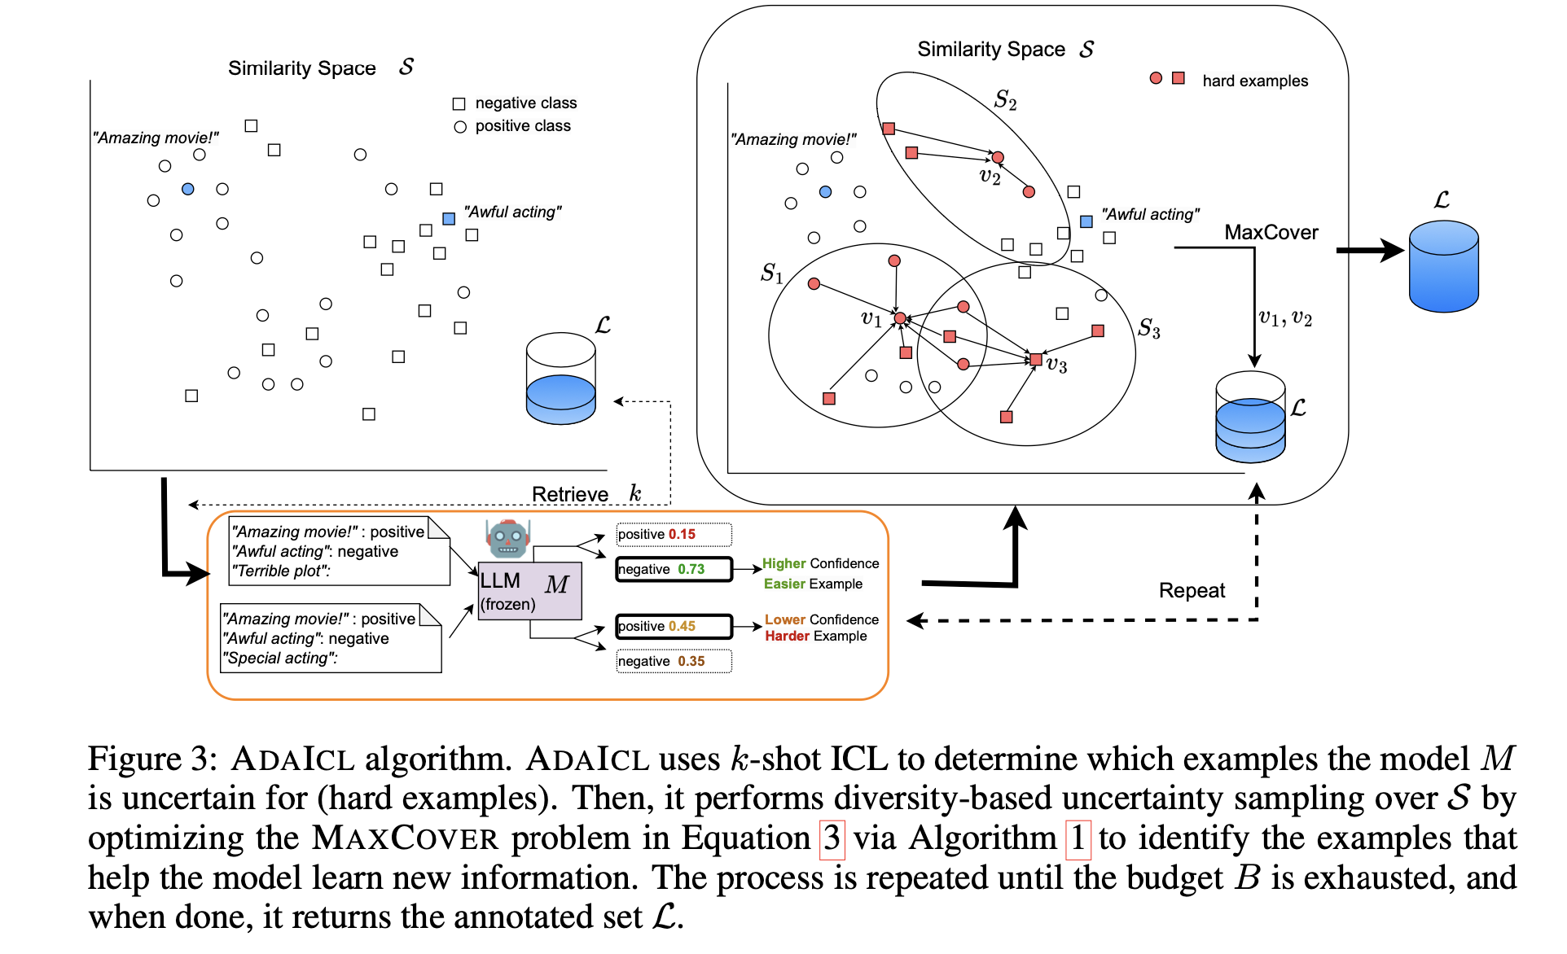
Max Cover

Slide 26
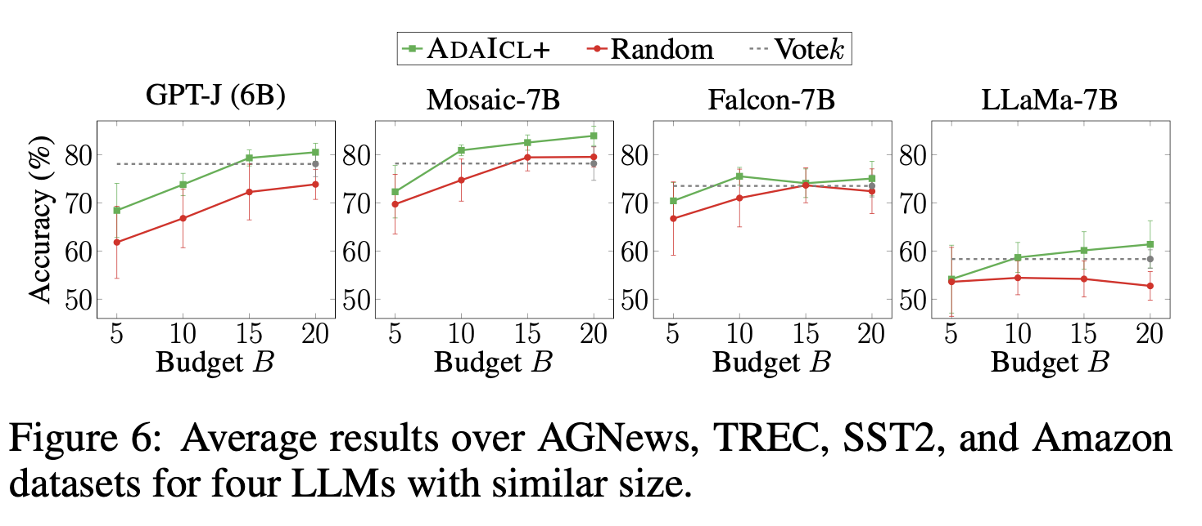
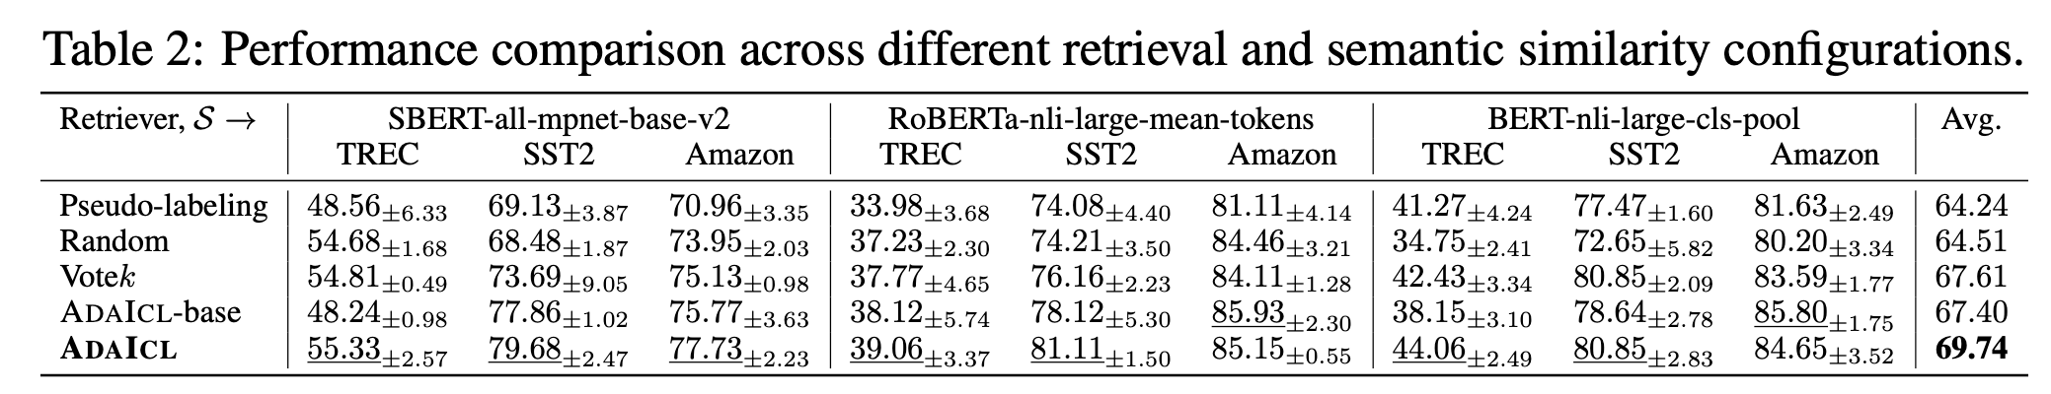
Max Cover

Slide 27
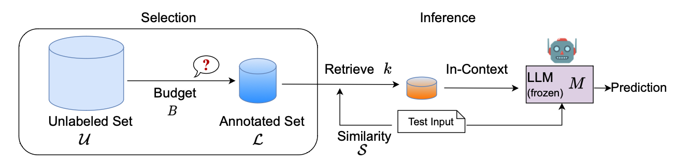
Discussion

Slide 28
Thanks

